Slide 1


Rob Schneider
<Date>

Slide 2

Outline
Executive Summary
Introduction
Methodology
Results
Conclusion
Appendix

Slide 3
Executive Summary
A multitude of methods in python were used to collect data from different websites, wrangle the data into workable datasets, create informative exploratory analysis, interactive maps and a dashboard.
To predict the outcomes of launches of the SpaceX Falcon 9 rockets, a decision tree classifier performed the best with an accuracy rating of over 80% on unseen testing data.

Slide 4
Introduction
This project is to determine if there is a method that can be used to accurately predict the outcome of a launch of a Falcon 9 given a certain set of features.
This project answers which model works best to answer our given question and produce additional analyses that can be performed as exploratory analysis is performed.

Slide 5

Section 1

Slide 6
Methodology
Executive Summary
Data collection methodology:
Perform data wrangling
Perform exploratory data analysis (EDA) using visualization and SQL
Perform interactive visual analytics using Folium and Plotly Dash
Perform predictive analysis using classification models

Slide 7
Data Collection
First data of interest to determine what data is needed to predict if a Falcon 9 first stage will land successfully.
The data was located and extracted from the SpaceX site and retrieved using an API.
Rocket, Launchpads, payload, core and past launch datasets were collected.
Certain features were extracted and placed into a single data frame.

Slide 8
Data Collection – SpaceX API
Data sets were collected by Web Scraping and the SpaceX API request.
Code used for data collection can be found: https://github.com/schneirc73/IBM_DS_Capstone
Convert JSON data into Data frame format
Request and Parse Get Request
Clean Data into usable format
Retrieve Data Sources from SpaceX

Slide 9
Data Collection - Scraping
Beautiful Soup and Python were utilized to scrape Wikipedia tables to collect additional information on launches that were needed for predictive analysis.
Notebook location: https://github.com/schneirc73/IBM_DS_Capstone

Slide 10
Data Wrangling
The main purpose of this notebook was to create the dependent variable for classification purposes. This notebook took all of the potential outcomes from a rocket launch and divide them into good/bad outcomes which were then converted into 0s and 1s.
Notebook location: https://github.com/schneirc73/IBM_DS_Capstone

Slide 11
EDA with Data Visualization
Using Scatterplots, bar graphs and line plots relationships between launch sites, orbit types and payload mass are visualized.
Location of Notebook: https://github.com/schneirc73/IBM_DS_Capstone

Slide 12
EDA with SQL
SQL was utilized to parse a database to view first successful missions, total payload mass of all launches, launch locations and a few other items of interest.
Notebook Location: https://github.com/schneirc73/IBM_DS_Capstone

Slide 13
Build an Interactive Map with Folium
The maps created in Folium are used to view the location of different launch sites used in the dataset. The maps allow the user to drill deeper into each location and view the success and failure of each launch instance.
Notebook Location: https://github.com/schneirc73/IBM_DS_Capstone

Slide 14
Predictive Analysis (Classification)
The predictive analysis covered multiple avenue of classification techniques including:
Decision Tree
K-Neighbors
SVM
Logistic Regression
The models were optimized using a grid search method, which determined the Decision Tree performed the best. The notebook can be found at: https://github.com/schneirc73/IBM_DS_Capstone

Slide 15
Results
Exploratory data analysis results
Interactive analytics demo in screenshots
Predictive analysis results

Slide 16

Section 2

Slide 17
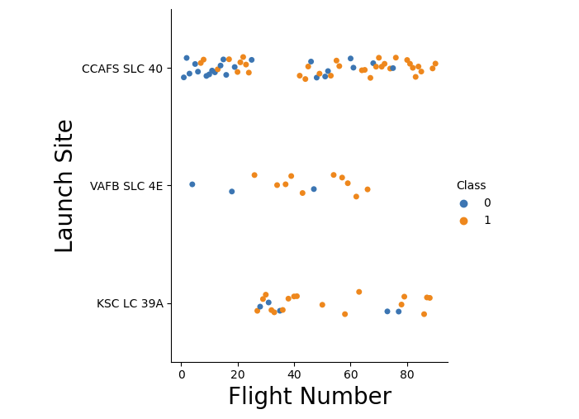
Flight Number vs. Launch Site
This plot shows the success and failures for different launch sites. This plot shows that both KSC LC 39A and VAFB SLC 4E both have a high degree of successful launches, when compared to CCAFS SLC 40 that high a higher volume of launches.

Slide 18
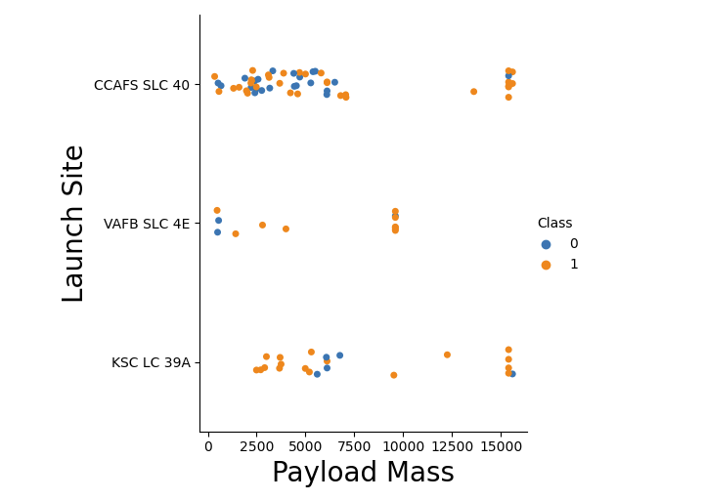
Payload vs. Launch Site
This plot shows a few areas of interest, firstly the higher payload mass seems to have a higher proportion of success. And VAFB SLC 4E didn’t launch any rockets above 10,000 payload mass.

Slide 19
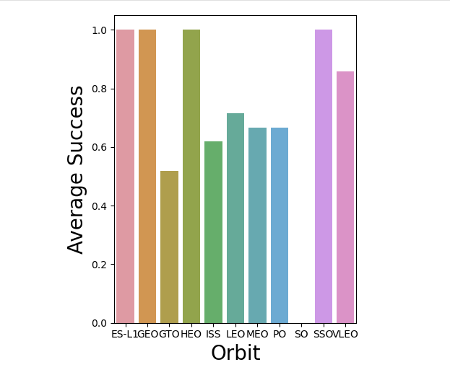
Success Rate vs. Orbit Type
Multiple Orbit types had a perfect success rate for launches and the average for all types is around 60%. With the lowest Orbit type SO not having a single success.

Slide 20
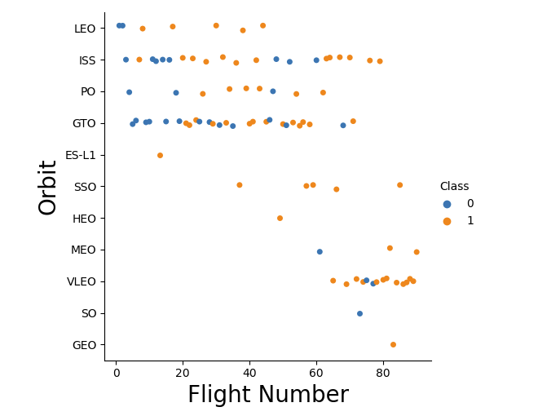
Flight Number vs. Orbit Type
The vast majority of flights occurred with LEO, ISS, PO and GTO orbit types. While SO and GEO both only had a single flight.

Slide 21
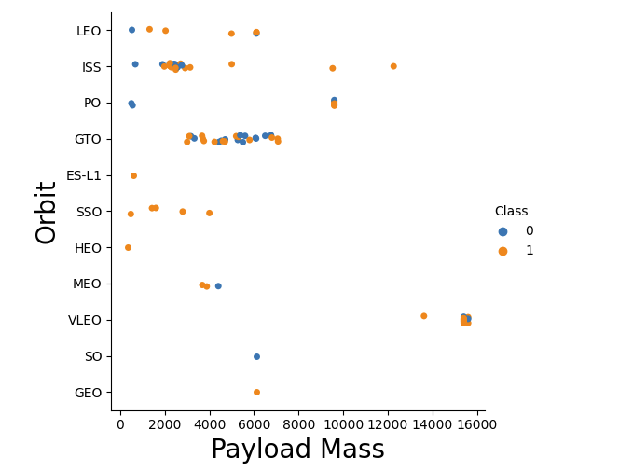
Payload vs. Orbit Type
The vast majority of Orbit types did not exceed a payload mass of 8,000. While ISS, PO and VLEO had launches above this threshold. Interestingly VLEO only had payload masses above the 8,000 threshold.

Slide 22
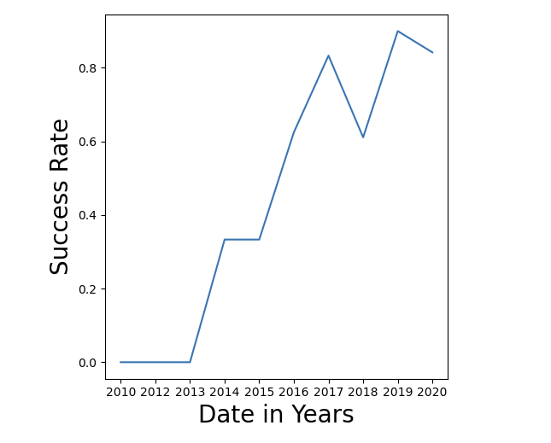
Launch Success Yearly Trend
This graph shows the progression of successful launches that have occurred overtime. Starting in 2014 the success rate steadily increased except for a dip in 2018 but the trend rebounded in 2019 to above 80%.

Slide 23
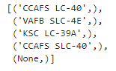
All Launch Site Names
Using SQL in python we found that there were only four launch sites in the dataset:
Launch Sites | Common Name
CCAFS LC-40 | Cape Canaveral
VAFB SLC-4E | Vandenberg Space Launch Complex 4
KSC LC-39A | Kennedy Space Center Launch Complex 39A
CCAFS SLC-40 | Cape Canaveral Space Launch Complex 40

Slide 24
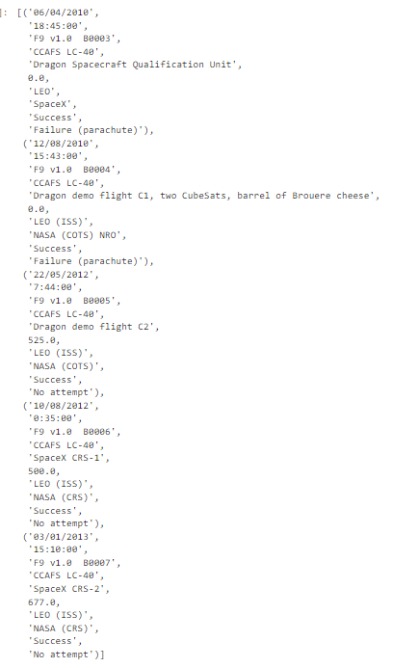
Launch Site Names Begin with 'CCA'
This query discovered the available information related to different launches that occurred at either of the Cape Canaveral Launch sites.

Slide 25
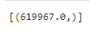
Total Payload Mass
The total Payload Mass that NASA launched in the given dataset was equal to 619,967.

Slide 26
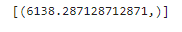
Average Payload Mass by F9 v1.1
The F9 v1.1 booster on average carried 6138.27 payload mass each launch.

Slide 27
First Successful Ground Landing Date
The first successful landing on a ground pad occurred in 01/08/2018 by a SpaceX’s Falcon 9 from the Cape Canaveral Air Force Station.

Slide 28
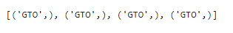
Successful Drone Ship Landing with Payload between 4000 and 6000
The GTO booster is the only booster to have successful utilized a Drone Ship landing with a Payload between 4,000 and 6,000.

Slide 29
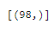
Total Number of Successful and Failure Mission Outcomes
There was a total of 98 successful missions and a 1 mission failure in the dataset.
Success
Failure

Slide 30
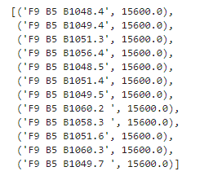
Boosters Carried Maximum Payload
The list below contains the name of boosters that carried the maximum Payload.

Slide 31
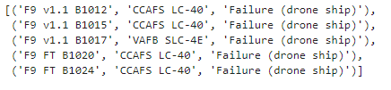
2015 Launch Records
The below list shows the boosters used for failures including a drone ship in the year 2015

Slide 32

Section 3

Slide 33
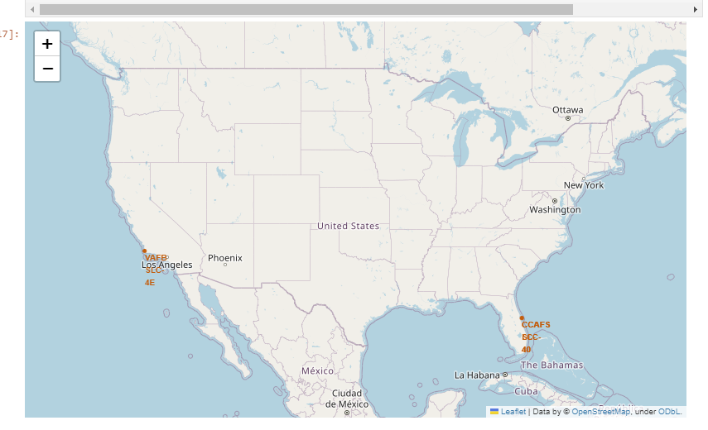
Launch Site Locations
This Folium map is displaying the launch locations of the SpaceX’s Falcon 9 rocket. With the majority of sites being located in Florida and a single location in California.

Slide 34
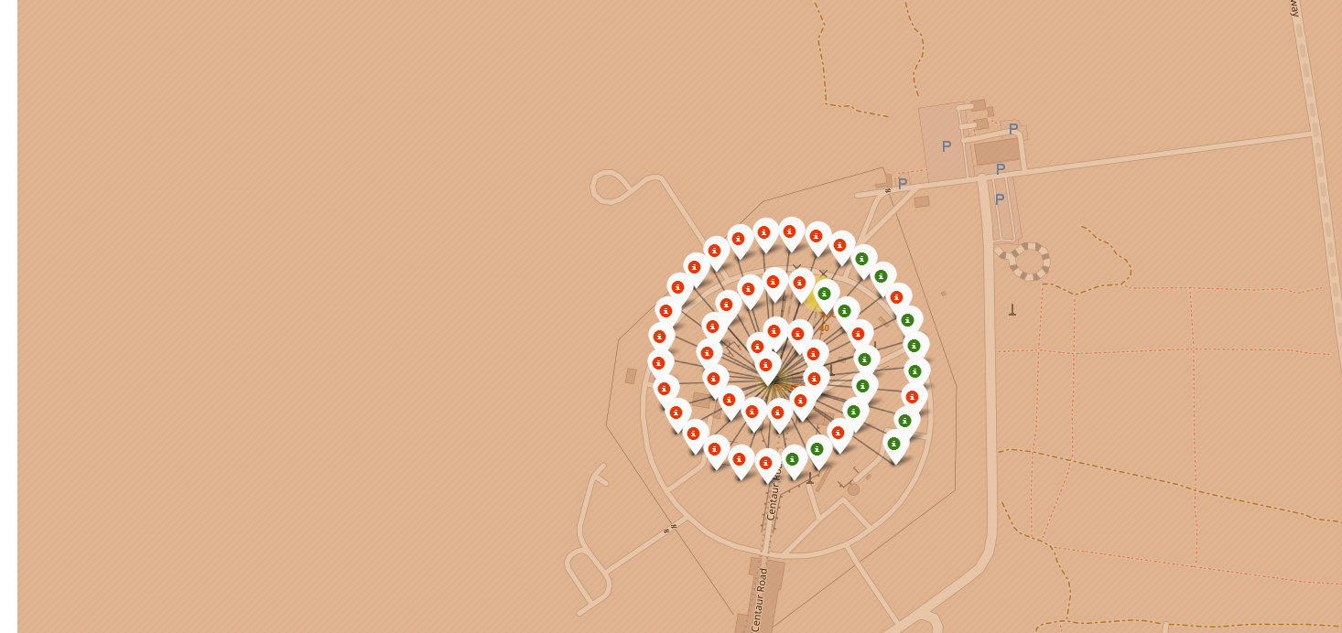
Location Success/Failure Instances
This folium map drills down into a single launch location and shows the successful and failure missions that occurred in the location. As this screenshot shows this location had a many failures (red) and success (green)

Slide 35
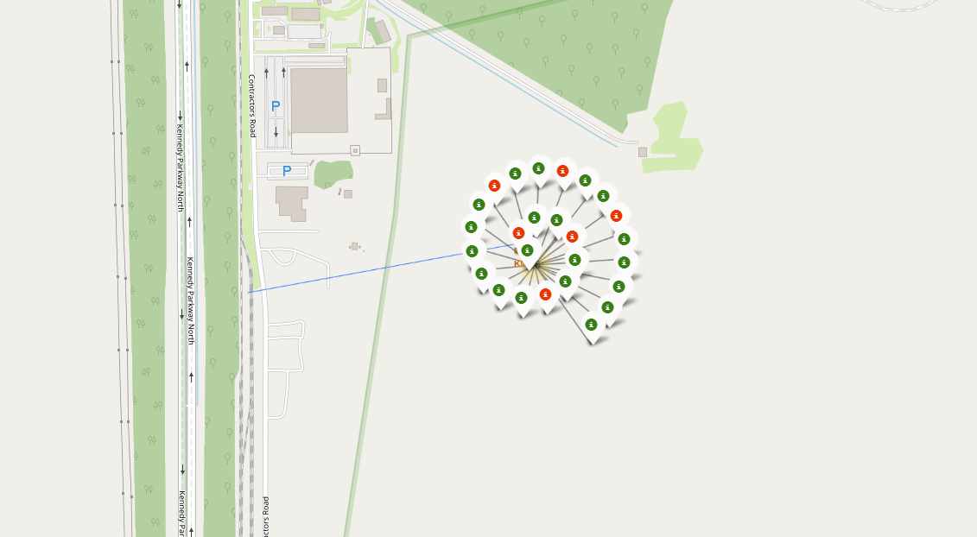
Public Domain Impact of Success
This folium map shows the distance a launch site has from a major railroad. This information may lead to additional research to be done to see if location to public domains has any impact of the success of a launch.

Slide 36

Section 4

Slide 37

Section 5

Slide 38
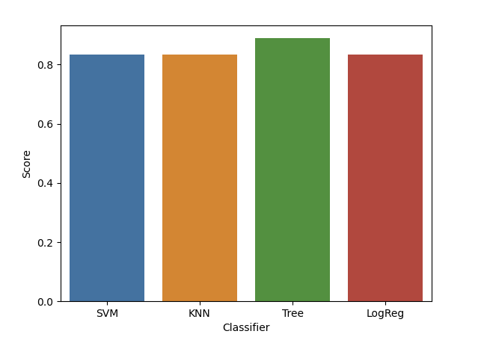
Classification Accuracy
To predict the outcome of a launch I utilized the following classification techniques:
Support Vector Machine
K-Nearest Neighbors
Decision Tree
Logistic Regression
The graph shows the Decision Tree performed the best on the test data above the 80% threshold.

Slide 39
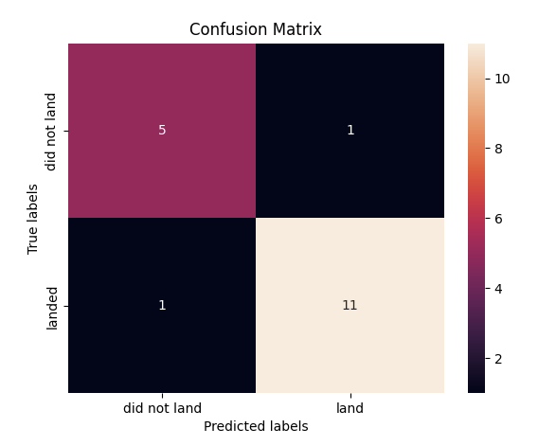
Confusion Matrix
This confusion matrix represents the results of the Decision Tree model, as it shows only 2 records were not correctly classified and 16 records being correctly classified.

Slide 40
Conclusions
Given the results of the decision tree classifier performing so well on the testing set, it may be useful for predicting the outcomes of future launches but given the small size of the testing set the next step would be to gather more data to test the model.
From the exploratory analysis the next steps for this analysis is examining how much impact (if any) public resources impact the success of launches that occur. The folium map showed how close the railroad was to a launch site, could this have had any impact on any failures that occurred on that site?

Slide 41
Appendix
All notebooks used to gather data, create graphics and perform classification can be found here: https://github.com/schneirc73/IBM_DS_Capstone
This project comes from the IBM Data Science Capstone course.

Slide 42


